Slide 1
AI Agentic Design Patterns with AutoGen
Exploring advanced AI behaviors and orchestration methods
Notes:
AI-generated content may be incorrect. --- Welcome to this presentation on AI Agentic Design Patterns with AutoGen. We will explore how agentic patterns define behaviors in AI systems and how AutoGen facilitates advanced multi-agent orchestration for next-generation AI solutions.

Slide 2
Presentation Roadmap
Title Slide
Introduction
Why Patterns Matter
AutoGen Overview
Pattern 1: Flexibility
Pattern 2: Scalability
Pattern 3: Collaboration
Pattern 4: Decision-Making
Multi-Agent Orchestration
Algorithms & Protocols
Notes:
Our presentation covers the fundamentals of agentic design patterns, the importance of reusable patterns, an overview of AutoGen, detailed exploration of key patterns like flexibility, scalability, collaboration, decision-making, and concludes with multi-agent orchestration and core algorithms.

Slide 3
Title Slide
Notes:
This slide introduces the course name and subtitle, accompanied by an abstract image illustrating AI networks, setting the tone for the presentation.

Slide 4

Course Name, Subtitle
Course Context
The course name sets the framework and scope for exploring AI agentic design.
Focus on AI Agentic Design
Emphasizes the design principles that enable autonomous AI agents.
AutoGen's Role
Highlights AutoGen's contribution in advancing AI capabilities and agentic design.
Notes:
--- The course name and subtitle provide context and highlight the focus on AI agentic design and AutoGen's role in advancing AI capabilities. Image source: Microsoft 365 content library

Slide 5

Abstract Image of AI Networks
Interconnected AI Systems
AI networks consist of interconnected nodes that communicate and collaborate dynamically for intelligent outcomes.
Dynamic Network Activity
AI systems exhibit dynamic interactions that evolve over time, enabling adaptability and learning.
Notes:
--- An abstract visual representation of AI networks symbolizes the interconnected and dynamic nature of agentic AI systems. Image source: Microsoft 365 content library

Slide 6
Introduction
Notes:
This section introduces agentic design patterns, emphasizing their role in defining AI agent behaviors and empowering next-generation AI systems.

Slide 7

Agentic Design Patterns Define AI Agent Behaviors
Blueprints of AI Behavior
Agentic design patterns act as foundational blueprints guiding AI agent behaviors in diverse environments.
Interaction Mechanisms
These patterns define how AI agents interact with each other and their surroundings effectively.
Adaptation in Complex Systems
Agentic patterns enable AI to adapt dynamically to changing conditions within complex systems.
Notes:
--- Agentic design patterns serve as blueprints that dictate how AI agents behave, interact, and adapt within complex systems. Image source: Microsoft 365 content library

Slide 8

Empower Next-Gen AI Systems
Leveraging AI Patterns
Using advanced patterns enables developers to build smarter AI systems with improved capabilities.
Intelligent AI Systems
Next-generation AI systems exhibit enhanced intelligence for complex problem solving.
Adaptive AI Capabilities
AI systems adapt dynamically to new data and environments to perform sophisticated tasks effectively.
Notes:
--- By leveraging these patterns, developers can create AI systems that are more intelligent, adaptive, and capable of handling sophisticated tasks. Image source: Microsoft 365 content library

Slide 9
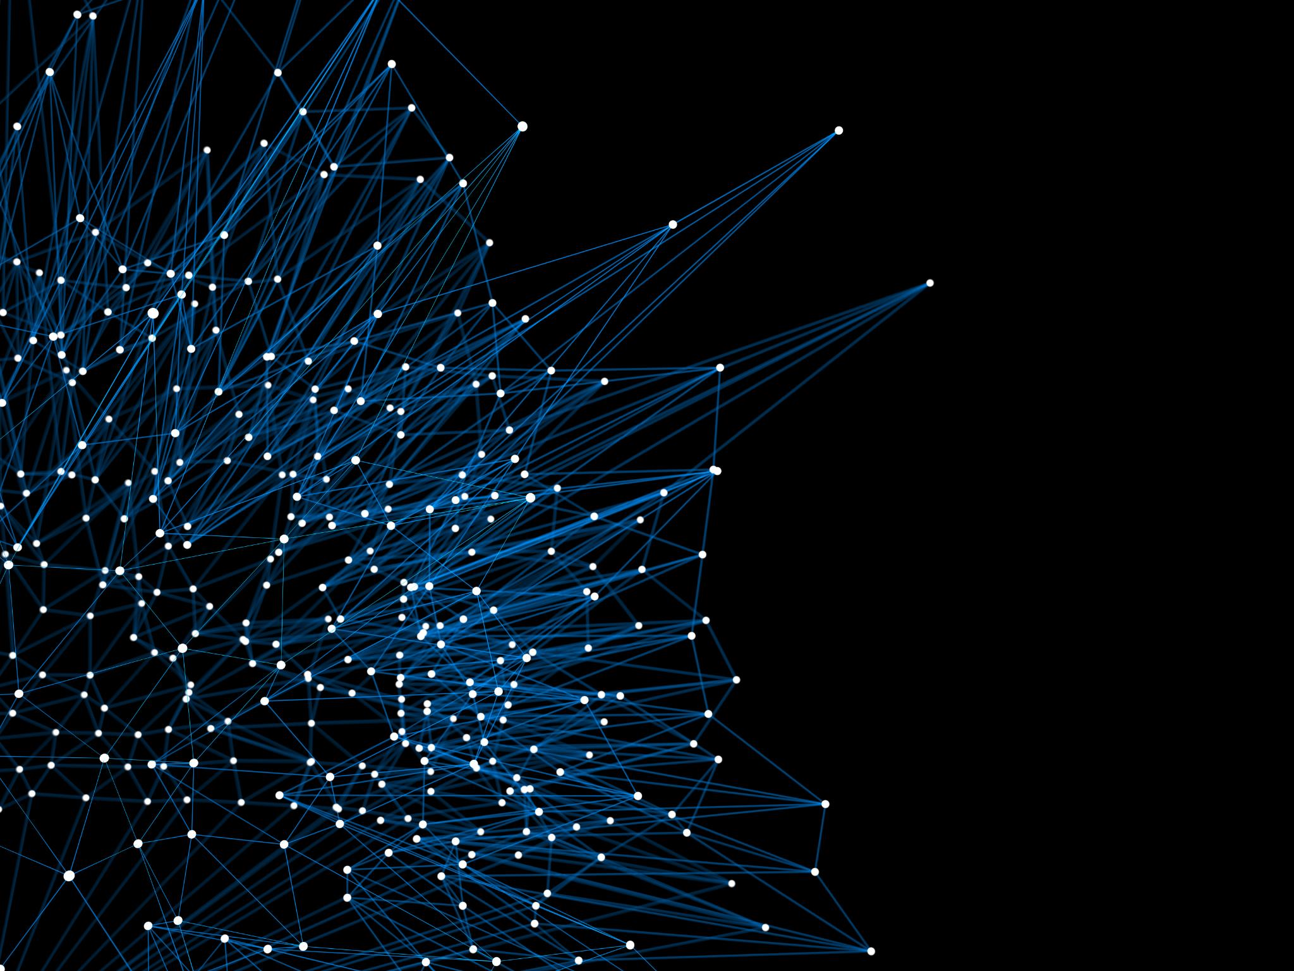
Image: Futuristic AI Illustration
Innovative AI Visualization
The illustration embodies the cutting-edge and forward-thinking aspects of artificial intelligence technology.
Representation of Technological Progress
Visual elements highlight growth and advancement in AI and related future technologies.
Notes:
--- A futuristic AI illustration visually reinforces the innovative and forward-looking nature of the technologies discussed. Image source: Microsoft 365 content library

Slide 10
Why Patterns Matter
Notes:
This section explains the importance of design patterns in AI development, focusing on reusability and system robustness.

Slide 11

Reusable Solutions Lower Development Effort
Time Efficiency
Reusable patterns significantly reduce development time by leveraging pre-tested solutions for AI systems.
Reduced Effort
Using reusable solutions lowers the effort required to develop complex AI applications effectively.
Notes:
--- Utilizing reusable patterns reduces the time and effort needed to build complex AI systems by providing tested solutions. Image source: Microsoft 365 content library

Slide 12

Ensure Reliable, Robust Systems
Reliability in AI Systems
Design patterns improve the reliability of AI systems by enabling consistent performance under different conditions.
Maintainability Through Design
Using design patterns enhances maintainability, allowing easier updates and modifications in AI systems.
Robust Performance
Design patterns ensure AI systems can handle diverse scenarios and unexpected conditions robustly.
Notes:
--- Design patterns help ensure that AI systems are reliable, maintainable, and capable of performing consistently under various conditions. Image source: Microsoft 365 content library

Slide 13

Image: Puzzle or Blueprint
Symbol of Structure
The puzzle image represents the structured and interconnected components within AI design patterns.
Modular Design Concept
The blueprint illustrates the modular and planned approach to AI development using design patterns.
Notes:
--- An image of a puzzle or blueprint symbolizes the structured and modular approach that design patterns bring to AI development. Image source: Microsoft 365 content library

Slide 14
AutoGen Overview
Notes:
This section introduces AutoGen, a platform that enables multi-agent orchestration for complex AI tasks.

Slide 15
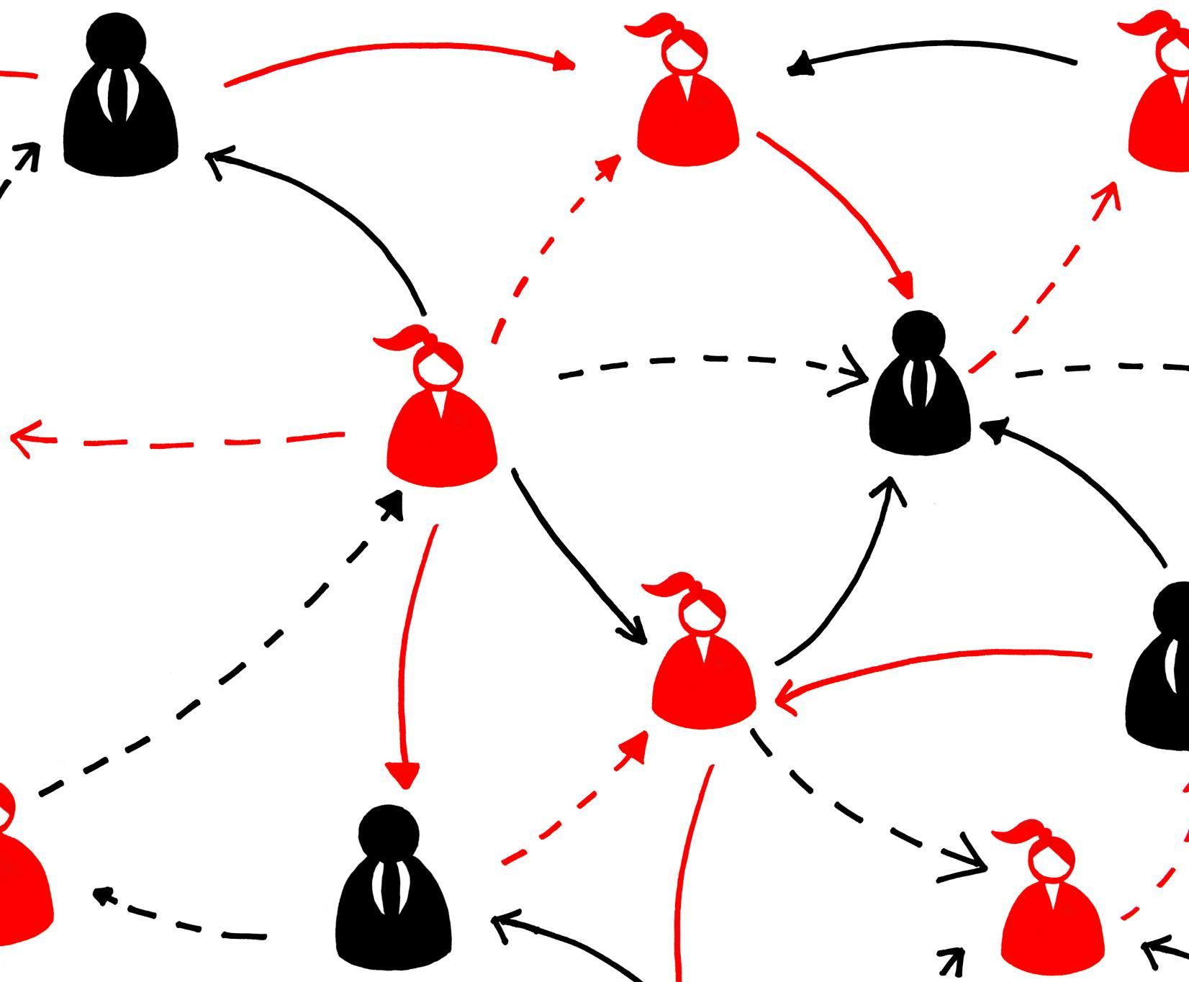
AutoGen Enables Multi-Agent Orchestration
Multi-Agent Coordination
AutoGen enables seamless coordination among multiple AI agents to enhance problem-solving capabilities.
Enhanced Problem Solving
Combined AI agents can tackle complex problems beyond what individual agents can achieve alone.
Notes:
--- AutoGen facilitates the coordination of multiple AI agents working together to solve problems beyond the capability of individual agents. Image source: Microsoft 365 content library

Slide 16

Agents Interact for Complex Tasks
Collaborative Problem Solving
Agents work together by sharing knowledge and skills to address complex challenges effectively.
Diverse Expertise
Interaction between agents brings together varied expertise necessary for adaptable task completion.
Adaptive Collaboration
Agents adapt their strategies through communication to handle dynamic and complex tasks efficiently.
Notes:
--- Through interaction and collaboration, agents can tackle tasks requiring diverse expertise and adaptability. Image source: Microsoft 365 content library

Slide 17

Image: Agents Collaborating
Cooperative Multi-Agent Systems
Agents collaborate effectively to achieve complex tasks in multi-agent AI systems.
AutoGen Enables Collaboration
AutoGen technology facilitates seamless interaction among AI agents for better outcomes.
Notes:
--- An image depicting agents collaborating highlights the cooperative nature of multi-agent AI systems enabled by AutoGen. Image source: Microsoft 365 content library

Slide 18
Pattern 1: Flexibility
Notes:
This section covers the flexibility pattern, which empowers agents to dynamically adapt to changing environments and goals.

Slide 19

Agents Dynamically Adapt to Change
Flexible Agent Design
Agents are built to be flexible, enabling adaptation to new information or situations effectively.
Dynamic Response
Agents dynamically respond to changes without needing a full system overhaul, ensuring efficiency.
Notes:
--- Agents designed with flexibility can respond to new information or situations without requiring a complete system overhaul. Image source: Microsoft 365 content library

Slide 20

Supports Evolving Goals
Flexibility Importance
Flexibility allows agents to adapt to changing objectives and priorities efficiently.
Ensuring Relevance
Adapting to evolving goals ensures agents remain effective and relevant over time.
Notes:
--- Flexibility enables agents to handle evolving objectives, ensuring relevance and effectiveness over time. Image source: Microsoft 365 content library

Slide 21

Image: Flowing Abstract Shapes
Fluidity in Design
Flowing shapes symbolize smooth transitions and dynamic movement in flexible design patterns.
Adaptability Concept
The abstract forms illustrate the adaptability and responsiveness of flexible design structures.
Notes:
--- The illustration of flowing abstract shapes represents the fluidity and adaptability inherent in the flexibility design pattern. Image source: Microsoft 365 content library

Slide 22
Pattern 2: Scalability
Notes:
This section focuses on scalability, allowing AI systems to manage increasing complexity and agent numbers efficiently.

Slide 23

Handles Growing Task Complexity
Scalable AI Architecture
Designs that can expand efficiently to handle increasing computational and data demands.
Maintaining Performance
Ensuring AI systems sustain high performance despite growing task complexity.
Notes:
--- Scalable designs ensure that AI systems maintain performance as task demands and data volumes increase. Image source: Microsoft 365 content library

Slide 24

Easily Integrate More Agents
Scalable System Design
Scalable systems are designed to easily incorporate additional agents without disrupting existing functions.
Expand Functionality
Adding agents allows the system to enhance its functionality and support new features effectively.
Increase Capacity
Seamlessly integrating more agents boosts the system's capacity to handle larger workloads.
Notes:
--- Systems built with scalability can seamlessly incorporate additional agents to expand functionality or capacity. Image source: Microsoft 365 content library

Slide 25
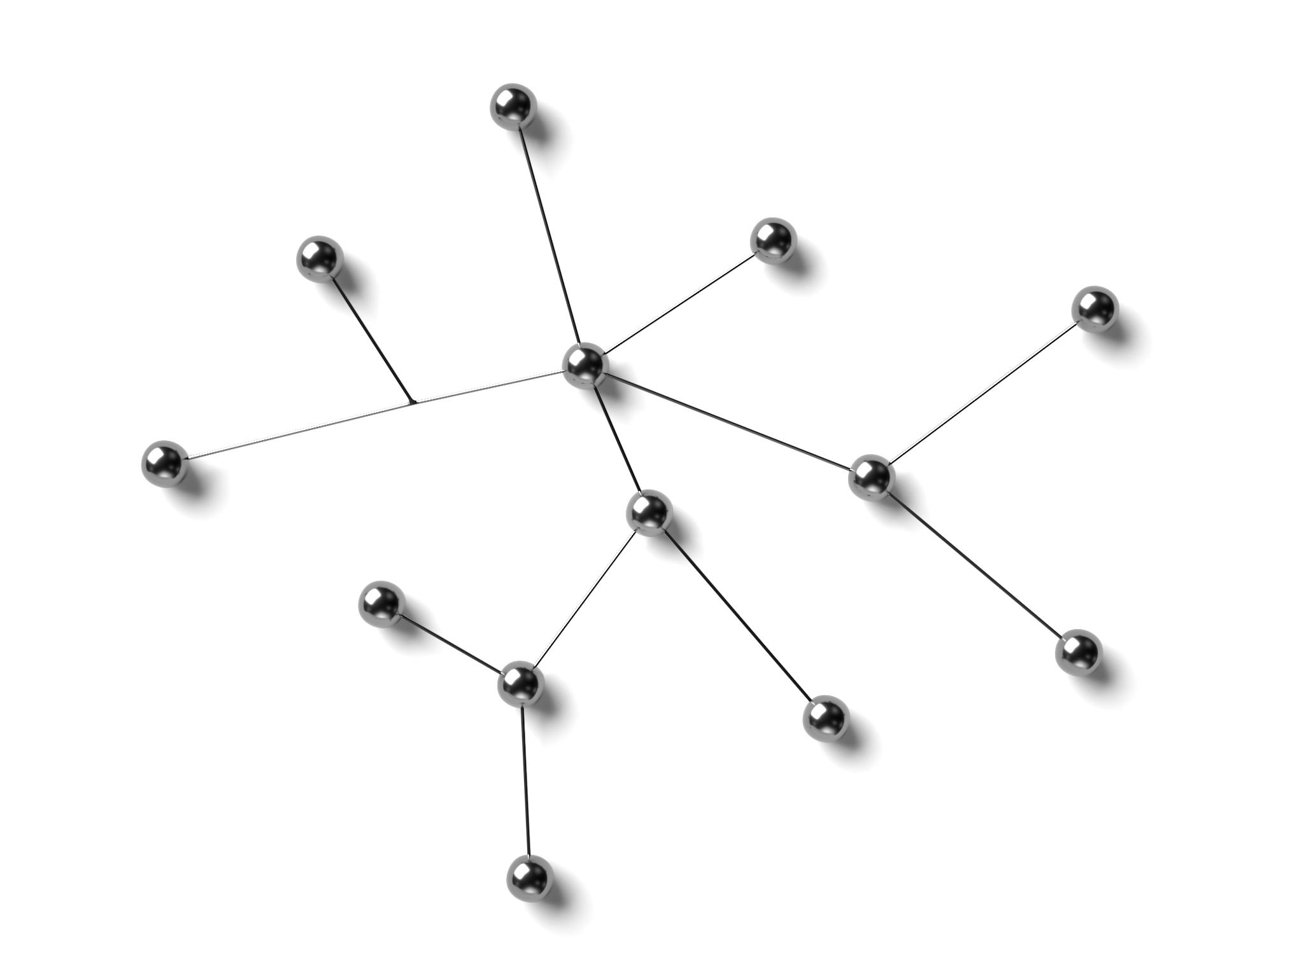
Image: Expanding Network Nodes
Network Expansion Concept
Expanding network nodes represent how AI systems scale by adding more agents dynamically.
Scalability in AI Systems
Scalability ensures AI agent systems handle increased workloads efficiently through node expansion.
Notes:
--- An image of expanding network nodes visually communicates the concept of scalability in AI agent systems. Image source: Microsoft 365 content library

Slide 26
Pattern 3: Collaboration
Notes:
This section explores the collaboration pattern where agents coordinate actions to achieve common objectives.

Slide 27
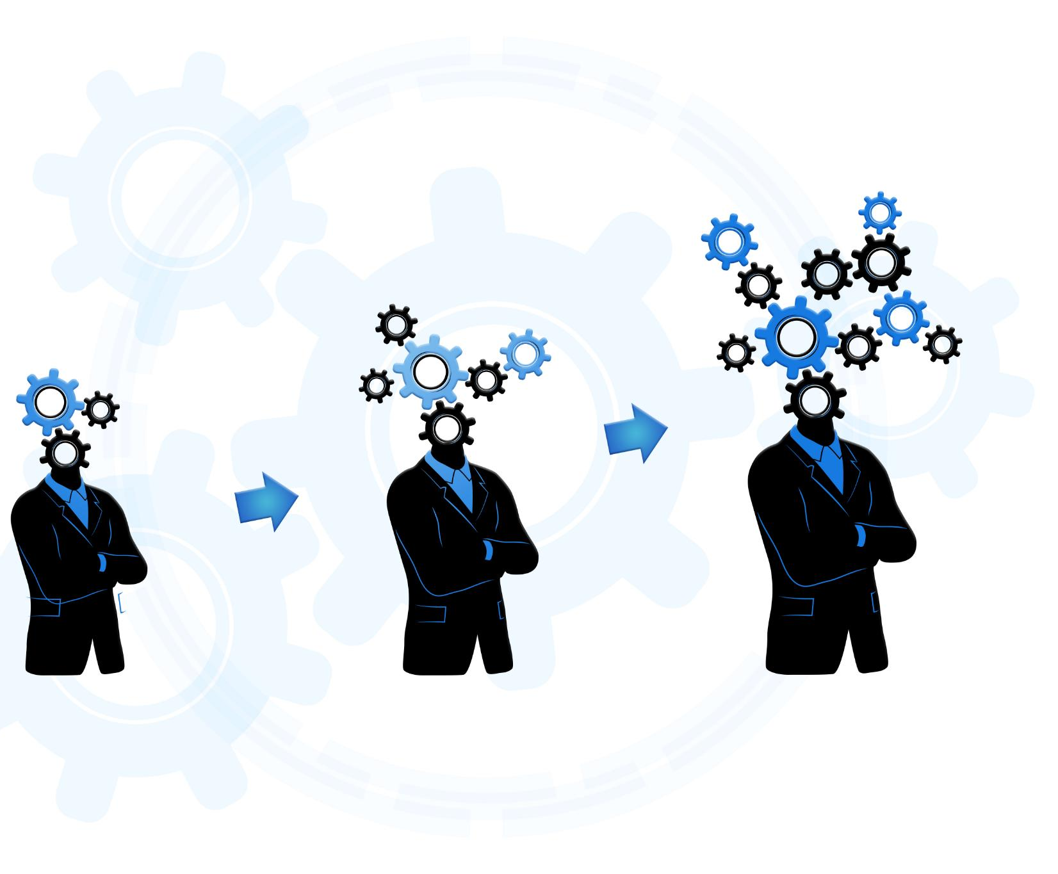
Agents Coordinate Actions
Collaboration and Synchronization
Agents work together to synchronize their efforts for improved coordination and system performance.
Information Sharing
Sharing information among agents enhances decision-making and overall efficiency in the system.
System Efficiency
Coordinated actions by agents lead to an efficient and optimized system operation.
Notes:
--- Collaboration enables agents to synchronize efforts, share information, and enhance overall system efficiency. Image source: Microsoft 365 content library

Slide 28

Achieve Shared Objectives
Power of Collaboration
Collaboration enables agents to combine their strengths to achieve complex objectives effectively.
Overcoming Isolation Challenges
Working together helps overcome challenges that isolated agents cannot easily resolve alone.
Notes:
--- Through effective collaboration, agents can accomplish goals that would be difficult for isolated agents to achieve. Image source: Microsoft 365 content library

Slide 29

Image: Teamwork Concept
Cooperative Spirit
Teamwork embodies a cooperative spirit where members work together toward common goals.
Joint Effort
Successful collaboration depends on the combined efforts of all team members.
Notes:
--- A teamwork concept image highlights the cooperative spirit and joint effort fundamental to agent collaboration. Image source: Microsoft 365 content library

Slide 30
Pattern 4: Decision-Making
Notes:
This section presents the decision-making pattern that empowers agents to make informed choices using data.

Slide 31

Agents Make Smarter Choices
Algorithm Utilization
Agents leverage advanced algorithms to analyze data and make informed decisions efficiently.
Analytics for Optimization
Analytics provide agents with insights to choose the most effective actions from available options.
Notes:
--- Agents utilize algorithms and analytics to select optimal actions based on available information. Image source: Microsoft 365 content library

Slide 32

Leverage Data for Outcomes
Data-Driven Decisions
Using data improves the accuracy of decisions and aligns actions with desired results.
Enhanced Effectiveness
Data insights help optimize strategies leading to more effective outcomes in various fields.
Notes:
--- Data-driven decision-making enhances accuracy and effectiveness in achieving desired results. Image source: Microsoft 365 content library

Slide 33

Image: AI Brain Visualization
Symbolism of AI Brain
The AI brain image represents intelligent processing and complex decision-making in artificial agents.
Intelligent Processing
The visualization illustrates how AI systems process information and simulate human-like intelligence.
Decision-Making Capabilities
The image reflects AI's capability to analyze data and make informed decisions autonomously.
Notes:
--- An AI brain visualization symbolizes intelligent processing and decision-making capabilities of agents. Image source: Microsoft 365 content library

Slide 34
Multi-Agent Orchestration
Notes:
This section covers the orchestration of multiple agents to ensure coordinated, efficient system behavior.

Slide 35

Defined Protocols Ensure Smooth Coordination
Communication Standards
Protocols set clear communication rules to ensure agents interact efficiently without misunderstandings.
Conflict Avoidance
Defined protocols prevent conflicts and redundancies by coordinating agent actions seamlessly.
Notes:
--- Protocols define how agents communicate and work together, avoiding conflicts and redundancies. Image source: Microsoft 365 content library

Slide 36
Efficient Resource Management
Resource Allocation Optimization
Orchestration improves resource allocation to ensure efficient use of available assets.
Workload Balancing
Balancing workloads helps prevent overload and improves system performance.
Bottleneck Minimization
Reducing bottlenecks ensures smoother workflows and faster task completion.
Notes:
--- Orchestration optimizes resource allocation, balancing workloads and minimizing bottlenecks. Image source: Microsoft 365 content library

Slide 37

Image: Connected Gears
Interlocking Gears
Connected gears symbolize how components work in unison, highlighting teamwork and coordination.
Synchronized Operation
Synchronization of gears represents seamless, efficient operation of complex systems working together.
Notes:
--- An image of connected gears illustrates the interlocking and synchronized operation of multi-agent systems. Image source: Microsoft 365 content library

Slide 38
Algorithms & Protocols
Notes:
This section discusses the underlying algorithms and communication protocols that guide agent interactions.

Slide 39

Agents Follow Communication Rules
Adherence to Rules
Agents strictly follow predefined communication protocols to maintain clarity in exchanges.
Ensuring Consistency
Consistent message exchanges prevent misunderstandings and promote effective communication.
Notes:
--- Agents adhere to defined communication rules to ensure clarity and consistency in message exchanges. Image source: Microsoft 365 content library

Slide 40

Structured Message Flows
Organized Interactions
Structured message flows organize communications systematically for clarity and efficiency.
Predictable Coordination
These flows enable predictable agent coordination, reducing errors during interactions.
Effective Communication
Structured flows ensure effective and smooth exchange of messages among participating agents.
Notes:
--- Structured flows organize interactions, enabling predictable and effective coordination among agents. Image source: Microsoft 365 content library

Slide 41

Image: Code and Flowchart
Code Representation
Code visually represents the underlying programming for agent communication protocols ensuring system functionality.
Flowchart Visualization
Flowcharts illustrate the logical sequence and flow in communication processes between agents.
Notes:
--- A visual of code and flowcharts represents the technical frameworks that support agent communication protocols. Image source: Microsoft 365 content library

Slide 42
Conclusion
Powerful Frameworks
AI agentic design patterns and AutoGen form powerful frameworks for multi-agent AI system development.
Flexibility and Scalability
These frameworks enable building flexible and scalable AI systems adaptable to various tasks and sizes.
Collaborative Intelligence
Multi-agent systems designed with these patterns support collaboration for intelligent decision-making.
Efficient Orchestration
Efficient orchestration of AI agents improves system performance and task management.
Notes:
In summary, AI agentic design patterns and AutoGen provide powerful frameworks for building flexible, scalable, and collaborative multi-agent AI systems that are capable of intelligent decision-making and efficient orchestration.

